Slide 1

EE:450 – Computer Networks
Discussion Session #1
August 25th, Fall 2010
Dimitris Antonellis

Slide 2
A little about me…
My Name is Dimitris Antonellis
E-Mail Address: dimitria@usc.edu
PhD Student in Electrical Engineering
  Delay Tolerant Networks
Past TA-ship experiences: EE465
Office hours in RTH 419
  Monday 4-6pm
  Wed 2-4pm
Dimitris Antonellis

Slide 3
My Responsibilities
  Conducting a weekly discussion session scheduled on Wednesday
  Maintaining the course DEN website
  Conducting office hours (open to all students)
  Designing and grading projects of session #1 (30500, 30506) and TBA session (30452) students ONLY
  Assisting (via e-mail) session #1 (30500, 30506) and TBA session (30452) students ONLY with their HWs, labs and projects
Dimitris Antonellis

Slide 4
Chenqian Jiang (Jessie)
E-Mail: chenqiaj@usc.edu
Office Hours:
  Monday: 9:00am ~ 11:00 am
  Location: TBA
Responsibilities include:
  Conducting a weekly discussion session (Wed)
  Conducting office hours (open to all sessions)
  Designing and grading the Socket Programming Project (Session 2 “30501” only)
  Assisting students (Session 2 “30501” only) with their assignments and labs
Dimitris Antonellis

Slide 5
Yun Wang
E-Mail: yunwang@usc.edu
Office: EEB 305, (213)-740-2244
Office Hours: W 11:00 ~ 1:00 PM
Responsibilities include:
  Conducting a weekly discussion session (Fridays)
  Conducting office hours (open to all sessions)
  Designing and grading the Socket Programming Project (Session 3 “30502” only)
  Assisting students (Session 3 “30502” only) with their homeworks and labs
Dimitris Antonellis

Slide 6
Who’s my designated TA for email contact?
Regardless of your enrollment in the discussion session:
  If you are enrolled in Session 1 (30500, 30506) or TBA session (30452) :
    Dimitris Antonellis (dimitria@usc.edu)
  If you are enrolled in Session 2 (30501)
    Chenqian Jiang (Jessie) (chengiaj@usc.edu)
  If you are enrolled in Session 3 (30502)
    Yun Wang (yunwang@usc.edu)
Dimitris Antonellis

Slide 7

Course webpages
Class Website (you must visit the class website frequently):
  http://den.usc.edu
  Webcasts for both lecture and discussion are available.
  Lecture and discussion notes, assignments, solutions, labs and project as well as important class announcements/news will be posted on the website.
  Whenever a document is posted on the website, you will be notified by email with EE450 in the subject line.
  DO CHECK and READ your emails every day!
  TAs may make mistakes – We appreciate your constructive feedback.
Dimitris Antonellis

Slide 8

Homeworks
6 – 7 homeworks this Semester.
  Unless you are registered with DEN, you must submit HWs and Labs in Lecture Class on the due date .
  Due date of HWs/Labs for DEN Remote Students is the day after the announced due date, at 11:59 am (just before noon).
  HW/Lab must NOT be emailed to TA or the professor.
Goal of Homework
  To help you learn the Material.
  For you to gain experience in solving networking-related problems.
Homework is difficult
  Help is available – but not at last minute.
  Start Early – Cannot answer 20 emails an hour before homework is due.
  Come to discussion/office hours with Questions.
Dimitris Antonellis

Slide 9
Extra Credit Labs
Extra credit Labs (Strongly recommended)
  Protocol analysis using Wireshark (Ethereal)
    2 labs, assigned before the Midterm
  Network simulation using OPNET
    3 labs, assigned after the midterm
  Each lab is worth 4 points added to your midterm grade out of 100
  i.e. you can potentially earn 20 points of extra credit if you
  Successfully fulfill all 5 labs
Introduction to Wireshark (Ethereal) and Instructions for Downloading and Installing OPNET Academic Version will be posted on DEN>Course documents in the corresponding folders.
Dimitris Antonellis

Slide 10
Hard Deadline Policy Regarding Collecting Graded Assignments and Grade Adjustments
Once grades for an assignment are ready for viewing on DEN, I will notify the class by email and announce a deadline as the last day to collect the graded assignment and resolve grading issues.
Due to extremely limited storage space, graded assignments for on-campus students that are not collected by the deadline will be disposed of and the students’ grade in that assignment will be penalized by 50%.
Please note that NO grade adjustments are allowed or accepted after the deadline for a specific assignment. This applies to students in both sessions as well as DEN remote students.
Dimitris Antonellis

Slide 11
How and When to Collect/Resolve
On-campus students have about 10 days from the time of the notification email to:
  Collect their assignment from Professor Zahid during his office hours on Tuesdays and Thursdays.
  Contact the designated grader (and if necessary the designated TA) to resolve any grading issues and have their grade updated in the grade book.
DEN Remote students have about 2 weeks from the time of the notification email to:
  Obtain their graded assignment through DEN, resolve the grading issues via email to the designated grader (and Dimitris if necessary) and have their grades updated in the grade book.
Dimitris Antonellis

Slide 12
Project
Client/server socket programming
  Mandatory (hard deadline strictly enforced)
  Important to learn
  Will expose you to the basics network programming
Requirements
  Knowledge of C or C++ programming (Medium to Skillful)
  Knowledge of Unix (Basic)
  Knowledge of Network Programming (Network Sockets)
    If you are new to socket programming, do study this tutorial carefully asap and before starting the project) at
      http://beej.us/guide/bgnet
TAs will guide and help you only with the project itself
They will NOT teach you C/C++ programming, debugging, Unix or network programming
Dimitris Antonellis

Slide 13
Project Platform
You must run and test your project on Nunki (nunki.usc.edu) which is a SunOS machine at USC.
It will be graded on nunki as well.
You may write your code in a unix editor on nunki or in any other editor elsewhere and transfer it to nunki later for testing.
You are not allowed to run and test your code on any other USC Sun machines. (A policy strictly enforced by ITS )
No MS-Windows programs will be accepted.
You can easily connect to nunki
  Locally: User room computers (they all have Xwin already installed and some even have ssh connections already configured).
  Remotely: Your own computer at home or at the office
Dimitris Antonellis

Slide 14
How to remotely connect to nunki
You need to download, install and run Xwin and VPN on your computer
  Open software.usc.edu in you web browser.
  Login using your USC username and password
  Select your operating system
  Download the latest xwin and VPN.
  Install them both on your computer.
  Check http://www.usc.edu/its/connect/index.html for more info
  Run and login to VPN, run Xwin, configure an SSH sesssion for nunki and login to nunki.
New to USC? Visit http://www.usc.edu/its/
An entire discussion session will be dedicated to explaining the project, requirements, grading criteria and submission guidelines.
Brace yourself , this project is no piece of cake!
Dimitris Antonellis

Slide 15

Discussion Class
Discussion is not a Lecture Class
In order to be useful I need your help
Please come ready with Questions
Do the homework before hand
  Start early! HW can not be done in just a few hours.
I want you to be able to point out the tricks or subtleties to some of the problems in networking
The more exposure you have to the subject, the more prepared you will be for the exams
Dimitris Antonellis

Slide 16

Format
I’ll typically give a short lecture on some of the key topics for the week
Go over some extra examples
Go over any questions
Let me know:
  If something is not clear
  If you can’t read my handwriting
  I’m speaking too fast
Dimitris Antonellis

Slide 17
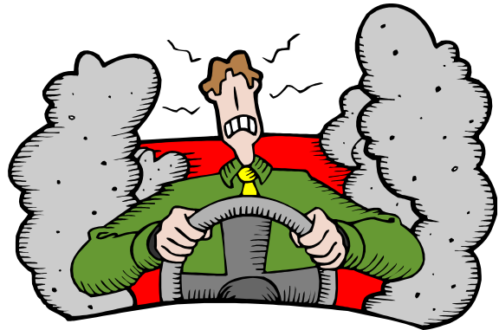
Getting Help
Methods
  Ask Me in Class
  Come to office hours
  Send me an email (Session#1 and TBA Students ONLY)
    Notice: If your on campus, It’s more effective to come and get help.
Dimitris Antonellis

Slide 18
Other Ideas
Use the web for help
  Be careful
  Searches on google usually return some very good info
You may talk with each other about concepts discussed in class, but remember:
  All assignments (HW,Labs and Project) require individual effort!
  Don’t copy! It doesn’t pay off and it is NOT allowed!!!
Dimitris Antonellis

Slide 19
Why Networks?
Networks are connections
Computers are powerful by themselves but many times more powerful when they are connected.
We live in a world where having information is not worth much, but being able to share it is very valuable
Dimitris Antonellis

Slide 20
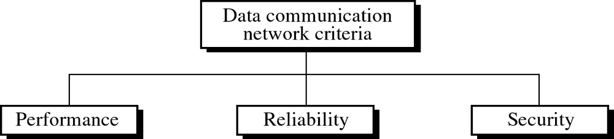


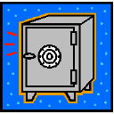
Three goals
Dimitris Antonellis

Slide 21
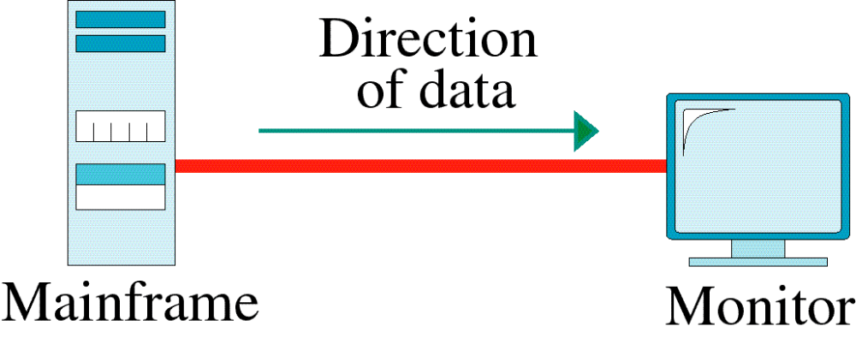
Simplex

Slide 22
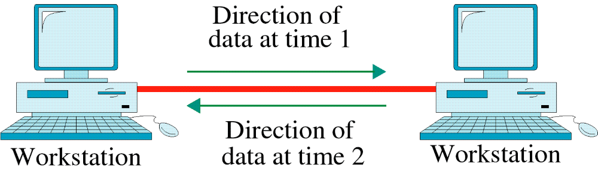
Half-Duplex
Dimitris Antonellis

Slide 23
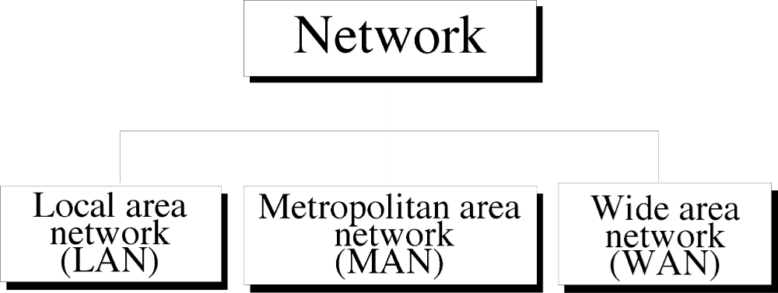
Dimitris Antonellis

Slide 24
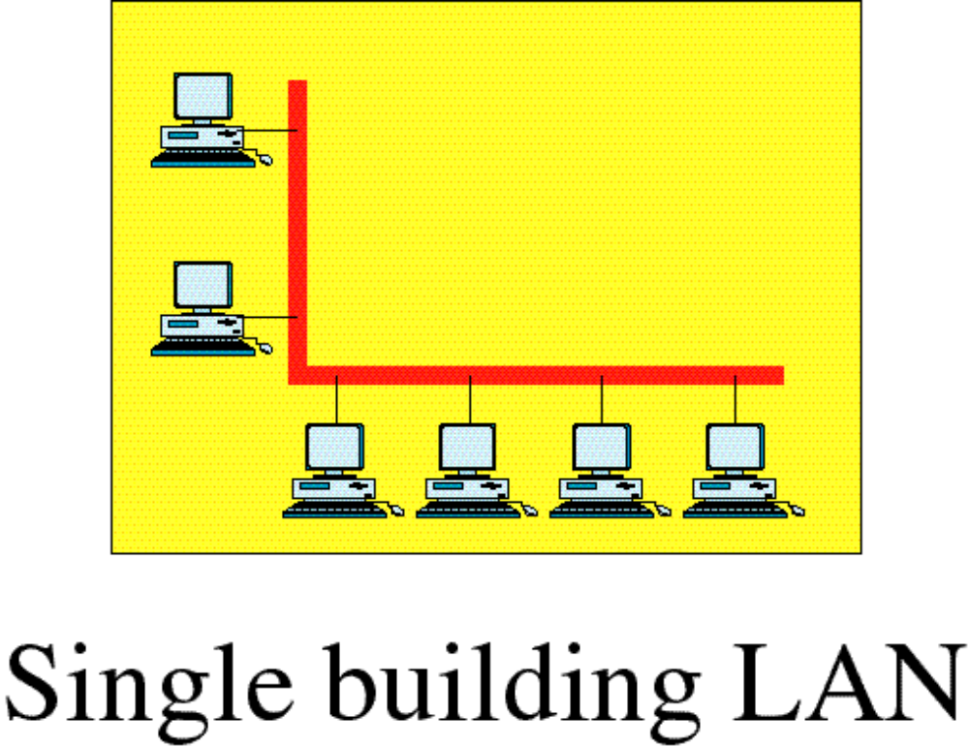
Local Area Network
Dimitris Antonellis

Slide 25
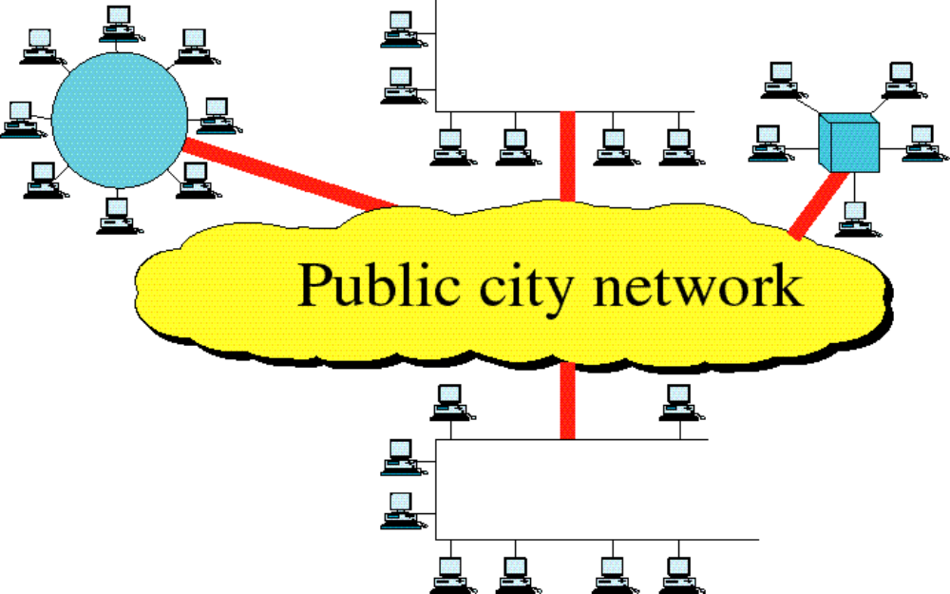
Metropolitan Area Network
Dimitris Antonellis

Slide 26
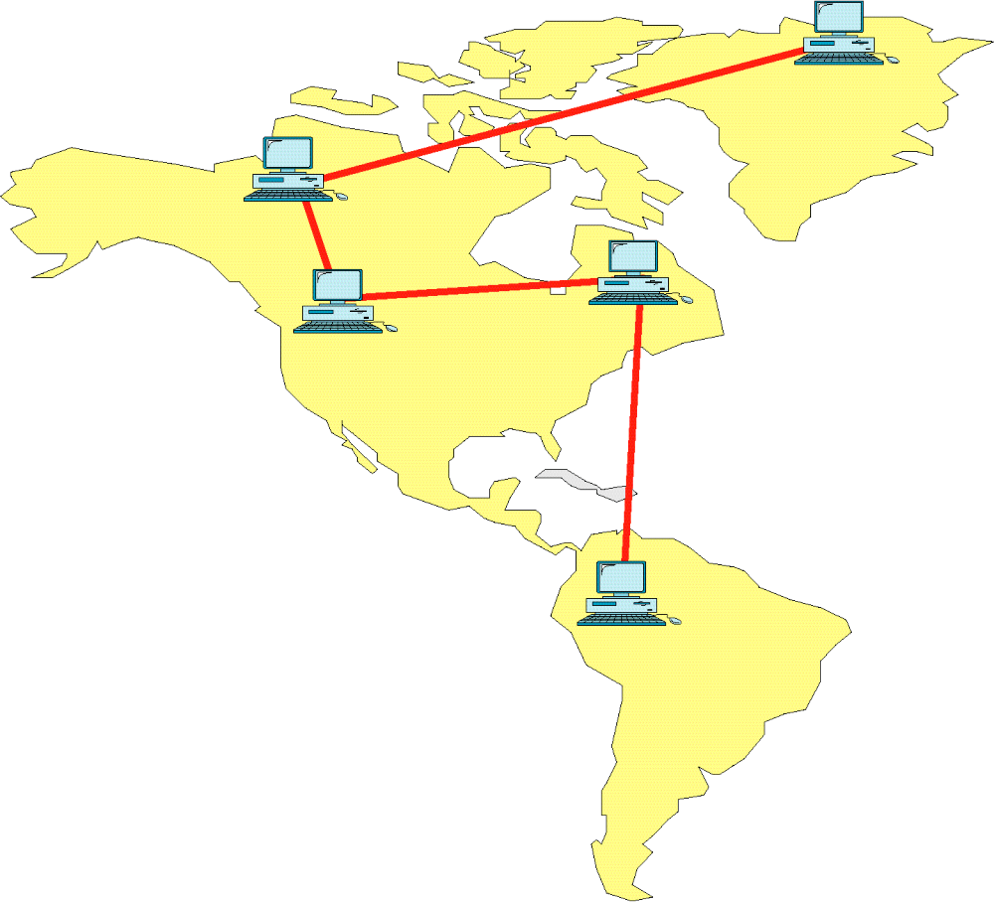
Wide Area Network

Slide 27
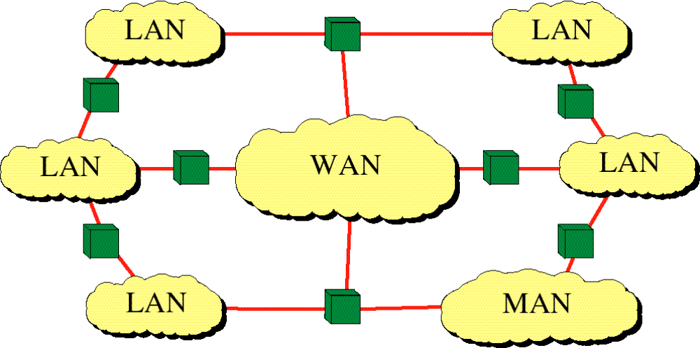
Internetwork
(Internet)

Slide 28
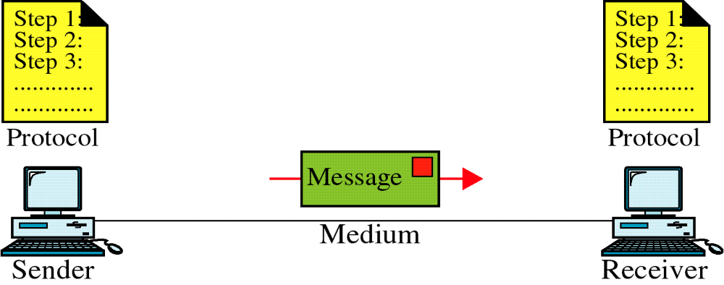
Some Networking Basics
Lets Define a Communication System
Dimitris Antonellis

Slide 29
Basics continued…
Communicating parties can be
  Telephones
  Cell Phones
  TV/Radio transmitters/receivers
  Computers
Dimitris Antonellis

Slide 30
Basics continued…
Transmission medium can be
  Twisted pair copper wire
  Coaxial cable
  Optical fiber
  Or simply air…
Dimitris Antonellis

Slide 31
Transmission
Transmitter
  Messages are converted into electrical signals
Transmission Medium
  Transmitter End: Electrical signals are converted into suitable transmission signals depending on the transmission medium. (EM waves for air, Light for optical fiber, etc)
  Transmission signals are propagated through the medium
  Receiver End: Converts the transmission signals into Electrical signals
Receiver
  Electrical signals are decoded to get the original message back.
Dimitris Antonellis

Slide 32
SIGNALS
The electrical signals can be ANALOG or DIGITAL
ANALOG – the amplitude can take infinite number of values
  Ex: TV/Radio transmission
DIGITAL – the amplitude can take finite number of values only
  Ex: Computer Communications (uses two logic values 0 and 1)
We will be dealing with DIGITAL transmissions
Dimitris Antonellis

